Slide 1

Time series: Train, validation and test sets
Notes:
1

Slide 2
Objectives
Understand the strategy for building data sets for training, validation and testing
Time series: Train, validation and test sets
2

Slide 3
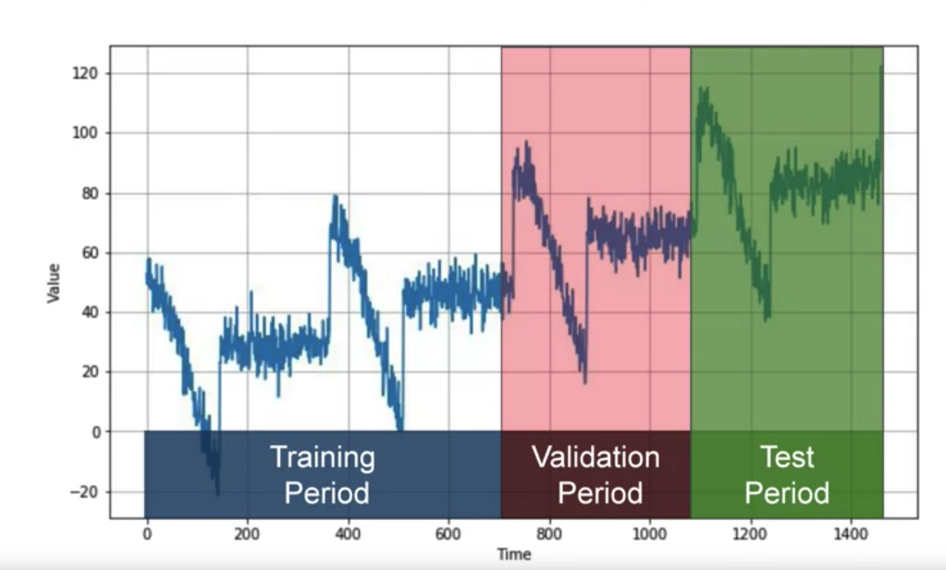
Strategy for building data sets
When working with time series data, the traditional approach to splitting data into training, validation, and test sets: fixed partitioning
Time series: Train, validation and test sets
3
Notes:
3

Slide 4
Strategy for building data sets
If the time series has some seasonality, you generally want to ensure that each period contains a whole number of seasons.
For example, one year, or two years, or three years, if the time series has a yearly seasonality.
You generally don't want one year and a half, or else some months will be represented more than others
Time series: Train, validation and test sets
4
Notes:
4

Slide 5
Strategy for building data sets
Training Set:
The initial portion of the time series is used as the training set.
It covers the earliest observations up to a certain point in time.
The model is trained on this data to learn patterns and relationships.
Validation Set:
The next portion of the time series is used as the validation set.
It follows the training set and typically covers a contiguous time period.
The model's hyperparameters and architecture are fine-tuned based on performance on this set.
The validation set helps to prevent overfitting to the training set and provides an intermediate evaluation before testing on unseen data.
Time series: Train, validation and test sets
5
Notes:
5

Slide 6
Strategy for building data sets
Test Set:
The remaining portion of the time series, often the most recent data, is reserved as the test set.
This set represents future observations that the model has not seen during training or validation.
The model's performance is evaluated on the test set to assess its ability to generalize to unseen data.
Time series: Train, validation and test sets
6
Notes:
6

Slide 7
Considerations when Splitting
No Data Leakage:
Ensure that the validation and test sets do not contain information from the future compared to the training set. This helps the model generalize better to unseen data.
Stationarity:
If the time series exhibits non-stationarity (i.e., the statistical properties change over time), it might be necessary to consider strategies such as differencing or detrending before splitting the data.
Time series: Train, validation and test sets
7
Notes:
7

Slide 8
Considerations when Splitting
Fixed or Rolling Window:
Decide whether to use a fixed window approach (e.g., the first 80% for training, the next 10% for validation, and the last 10% for testing) or a rolling window approach (e.g., using a moving time window for training, validation, and testing).
Multiple Train-Validation-Test Splits:
In cases where the dataset is large, multiple train-validation-test splits may be performed for robust evaluation.
Time series: Train, validation and test sets
8
Notes:
8

Slide 9
Considerations when Splitting
Cross-Validation:
Traditional k-fold cross-validation might not be directly applicable to time series data due to the temporal aspect. However, techniques like time series cross-validation (e.g., walk-forward validation) can be employed.
Time series: Train, validation and test sets
9
Notes:
9

Slide 10
Process for training time series data
1. Train your model on the training period: find the right architecture
2. Evaluate it on the validation period: desired performance, measured
3. retrain using both the training and validation data
4. test on the test period to see if your model will perform just as well
5. retraining again, using also the test data.
→ why have you do like that?
Time series: Train, validation and test sets
10
Notes:
10

Slide 11
Strategy for building data sets
Roll-forward partitioning:
We start with a short training period, and we gradually increase it, say by one day at a time, or by one week at a time. At each iteration, we train the model on a training period. And we use it to forecast the following day, or the following week, in the validation period
Time series: Train, validation and test sets
11
Notes:
11

Slide 12
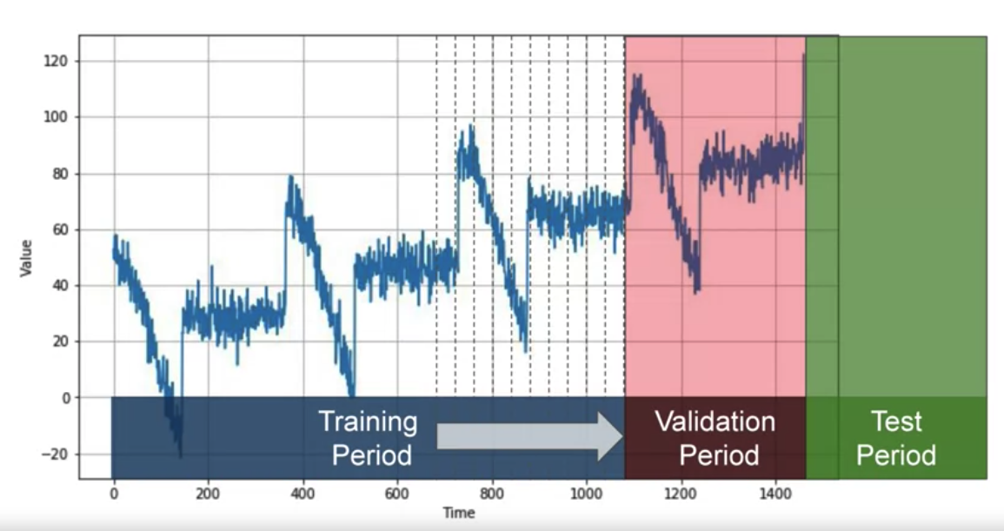
Strategy for building data sets
Roll-forward partitioning:
Time series: Train, validation and test sets
12
Notes:
12

Slide 13
Summary
Understand the strategy for building data sets for training, validation and testing
Time series: Train, validation and test sets
13

Slide 14
Q & A
Time series: Train, validation and test sets
14

